Slide 1
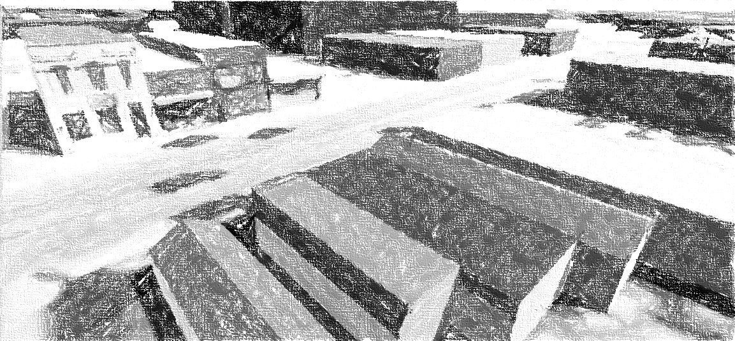
Improving Design Processes Through Interactive Geodesign
GIS Masters Project
By Louis Burns
Advisor: Dr. Brian J. Berry
August 11, 2017

Slide 2
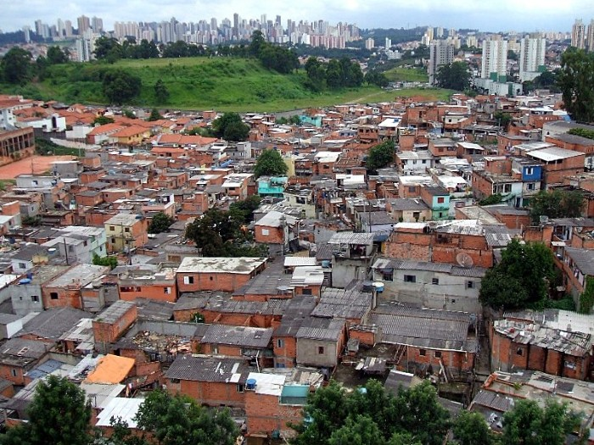
Notes:
We start off the presentation with the context of reminding everyone that the way we currently build things is less than optimal for most people.

Slide 3
Geodesign = GIS + Design
(Batty 2013)
Notes:
A definition.

Slide 4
Design Interaction
Games Simulations
Notes:
More definitions – we can design interactions for better design feedback. Also, there is a spectrum between gaming and simulation. The spectrum slides along the fidelity of the representation and experience. Fidelity in this sense refers to system realism or accuracy.

Slide 5
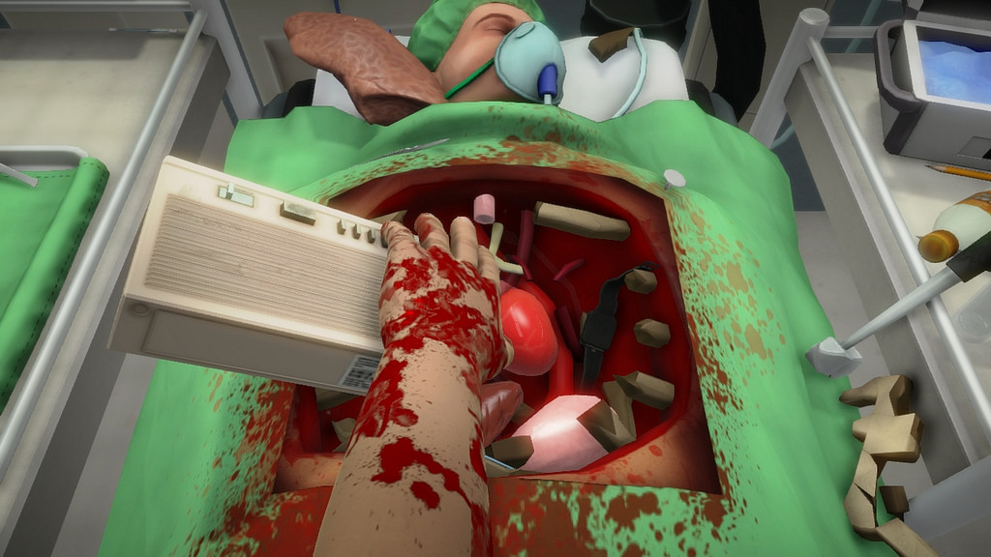
Notes:
This is a surgical game (low fidelity).

Slide 6
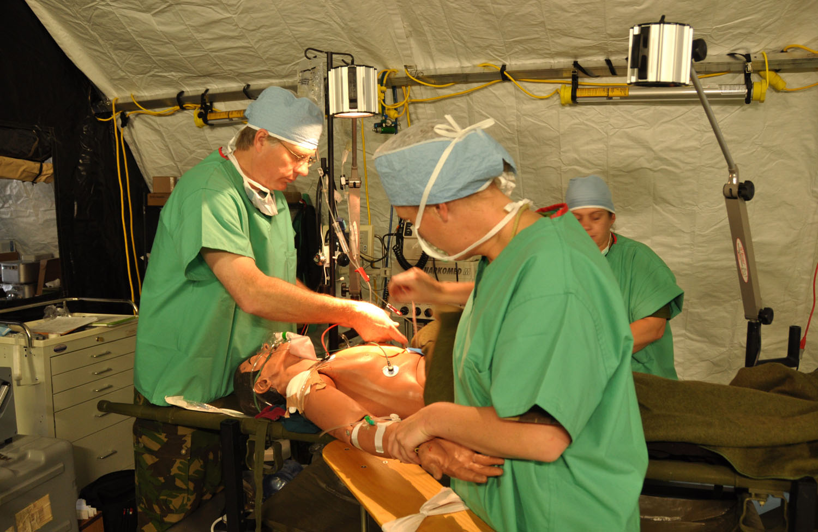
Notes:
This is a surgical simulation (high fidelity).

Slide 7
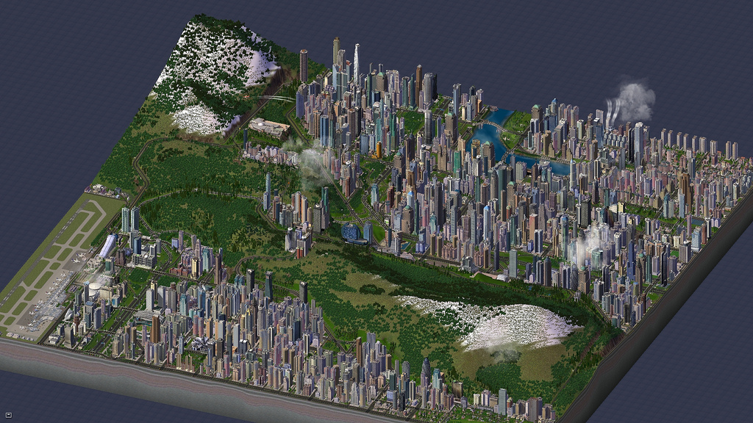
Notes:
This is a city game with moderate amounts of fidelity.

Slide 8
Interactive Urban Design?
Notes:
Can we design our built environment with better feedback mechanisms?

Slide 9
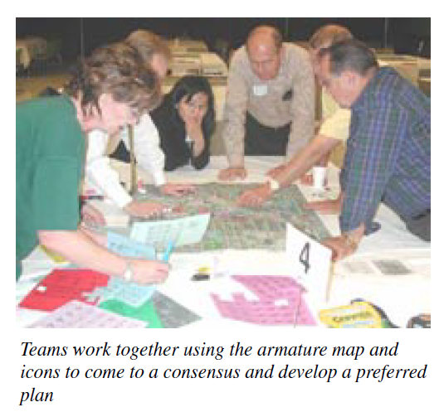
Notes:
The current best practice for community feedback are charrettes where members of the public are invited to come give feedback.

Slide 10
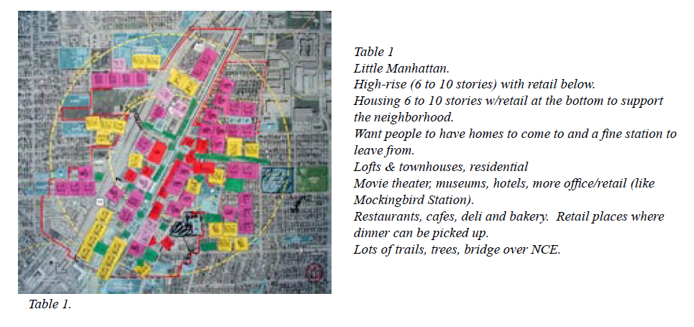
(Calthorpe Associates 2013)
Notes:
This is an example of part of the charrette process from Richardson, Texas.

Slide 11
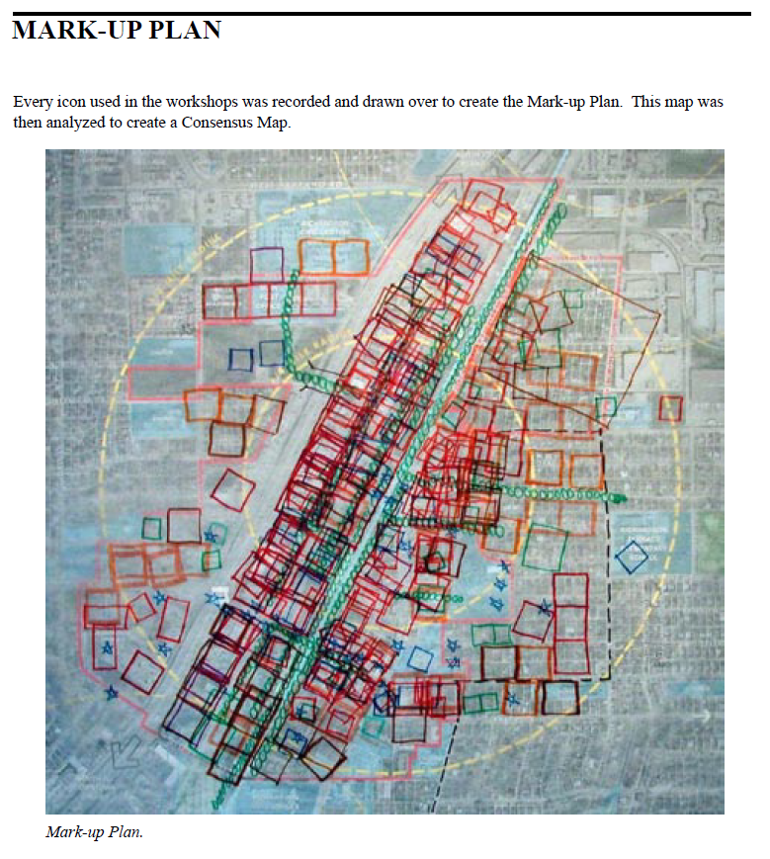
Notes:
This is an abstraction of the prior map.

Slide 12
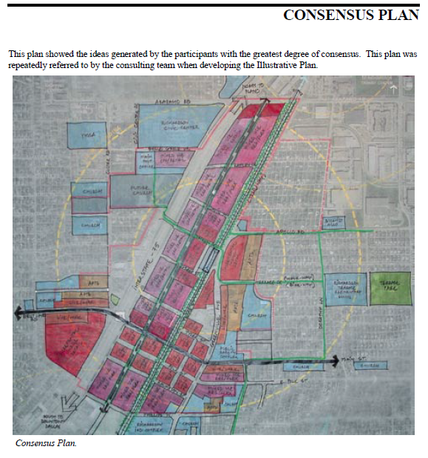
Notes:
Finally, we have a synthesis of the input.

Slide 13
50 participants / 100,000 population of Richardson = 0.05% representation
Consensus!
Notes:
The participation rate from that example.

Slide 14
Motivation for the Project:
Charrettes often a once-a-decade event
Not everyone can attend
Those who can are not representative
Design input is limited
Very little iteration
Very little interaction with data
No way to check outcomes
Fixing it later is HARD

Slide 15
Proposal
Create an interactive GIS game prototype to simulate the real estate development process
Instantiate the prototype to a local study area
Evaluate different Levels of Detail

Slide 16
Proposal
Create an interactive GIS game prototype to simulate the real estate development process
Instantiate the prototype to a local study area
Evaluate different Levels of Detail

Slide 17
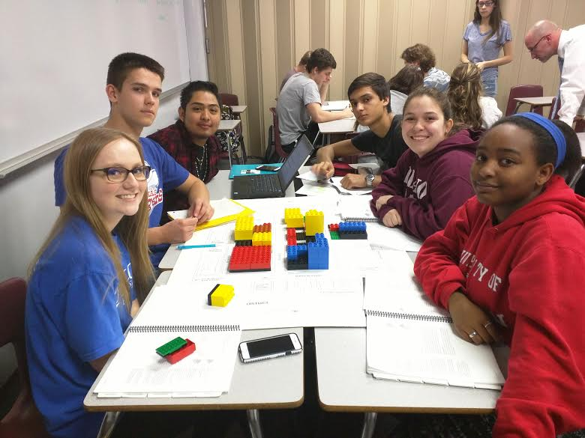
Notes:
This was the main precedent. UrbanPlan is a program of the Urban Land Institute. It simulates a real estate infill development across six city blocks. ULI members volunteer for a 3 session experience – two planning/development facilitations, and one mock city council presentation. Personally, I volunteered for about a dozen sessions.

Slide 18
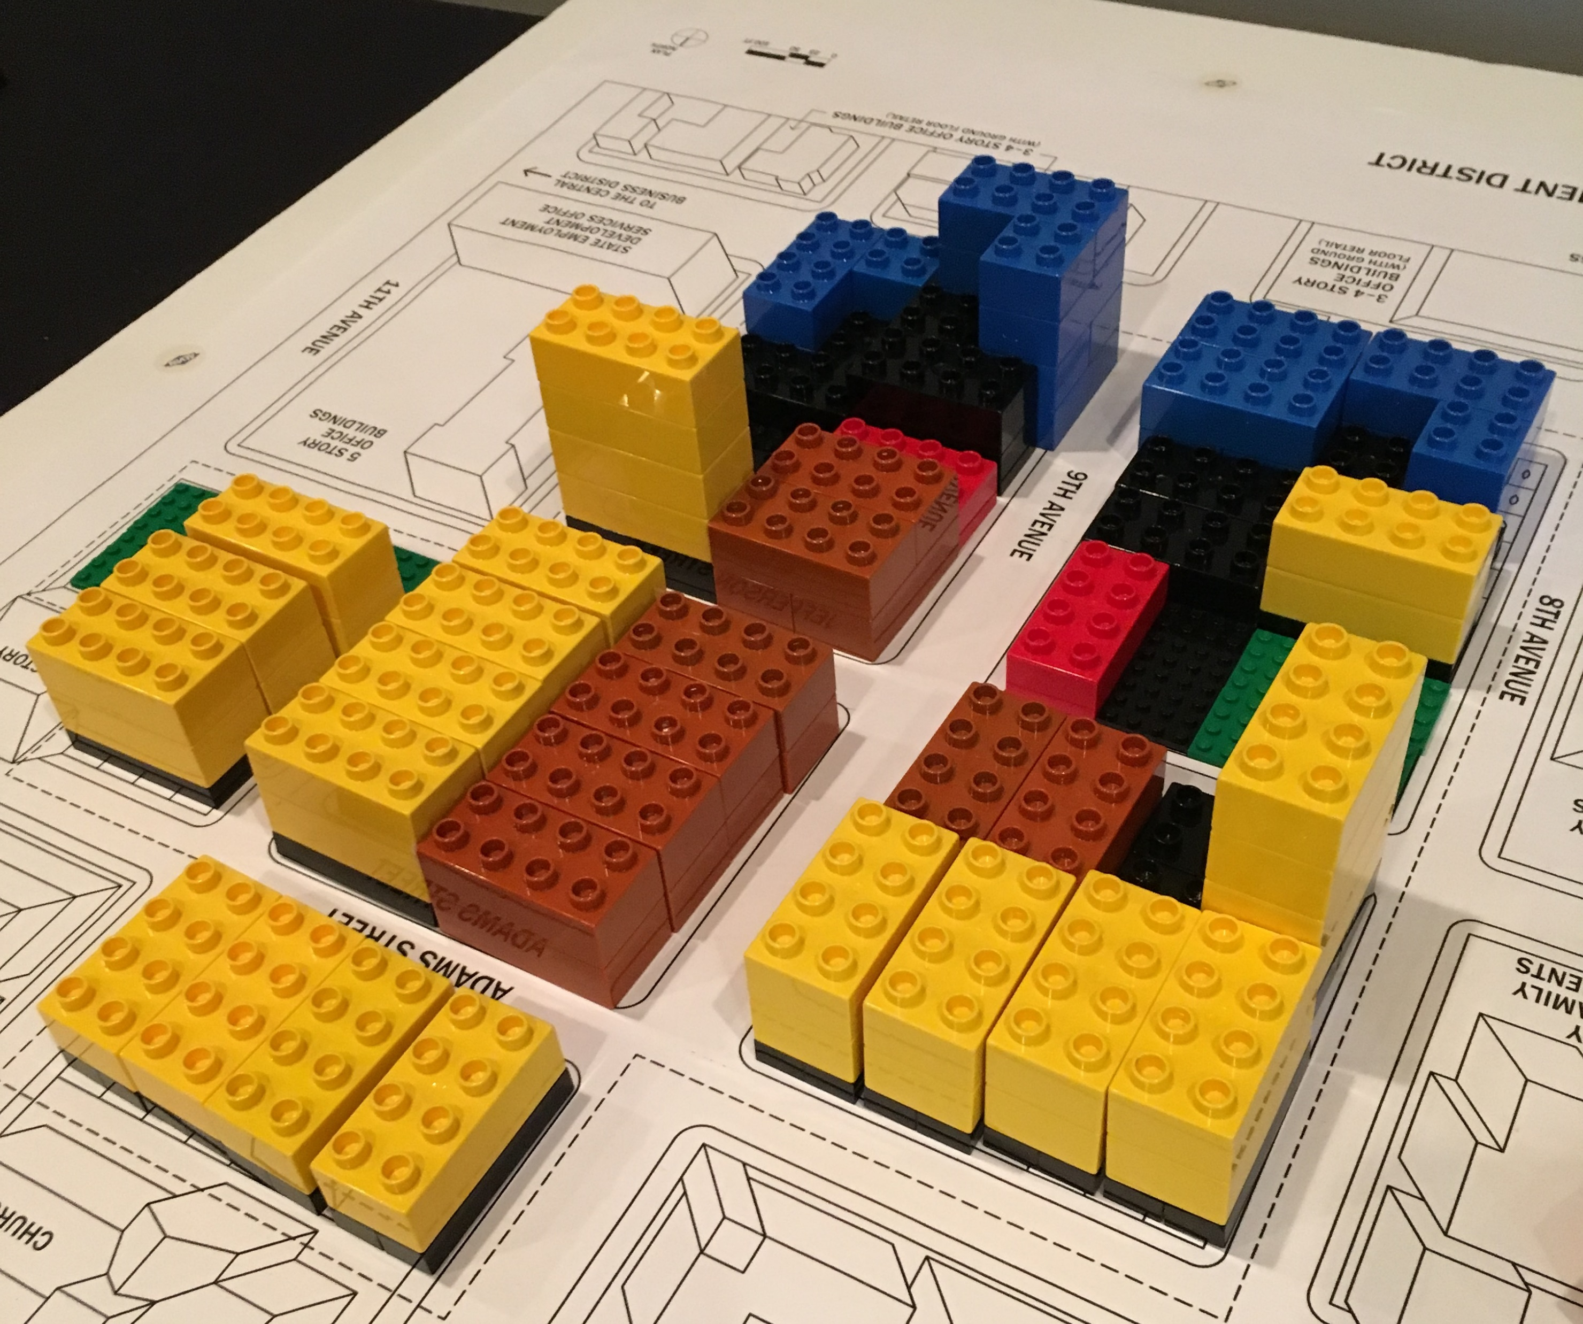
Notes:
This is a close up of the site plan.

Slide 19
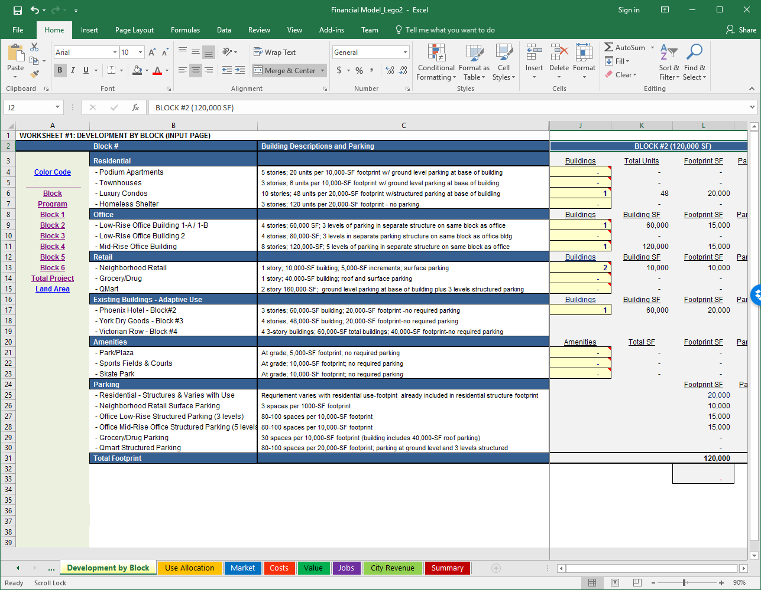
Notes:
This is the associated spreadsheet. Notice there are 8 sheets. If one piece on the board is changed, multiple sheets have to be updated and so iteration is difficult.

Slide 20
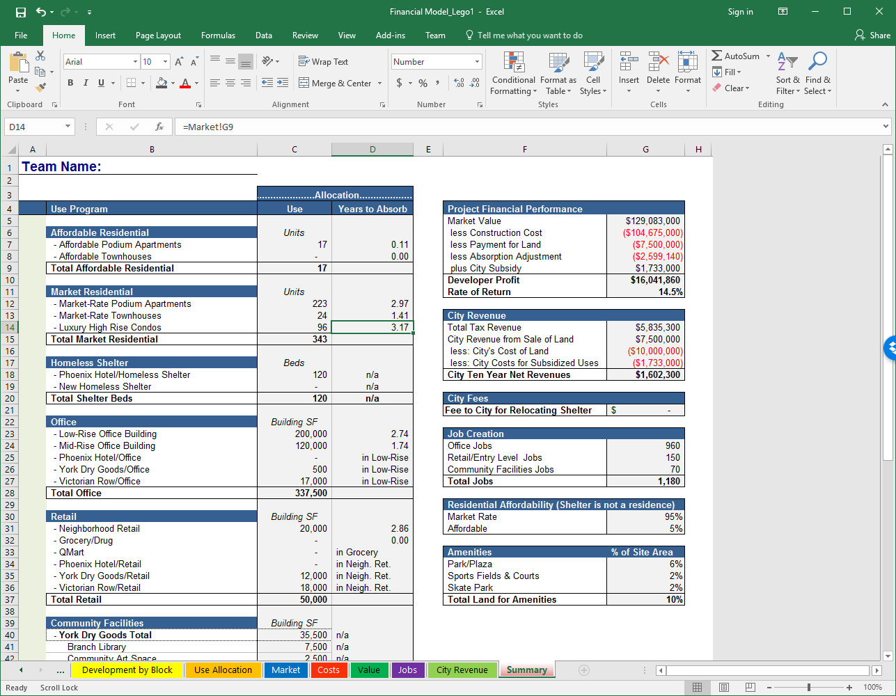
Notes:
This is the summary tab. When facilitating, this is the one you look at first to check the required investor return and net revenue to the city. After that, you start troubleshooting deeper into the numbers. Next, I would typically look at the absorption rate to see if one type of building or use was overbuilt.

Slide 21
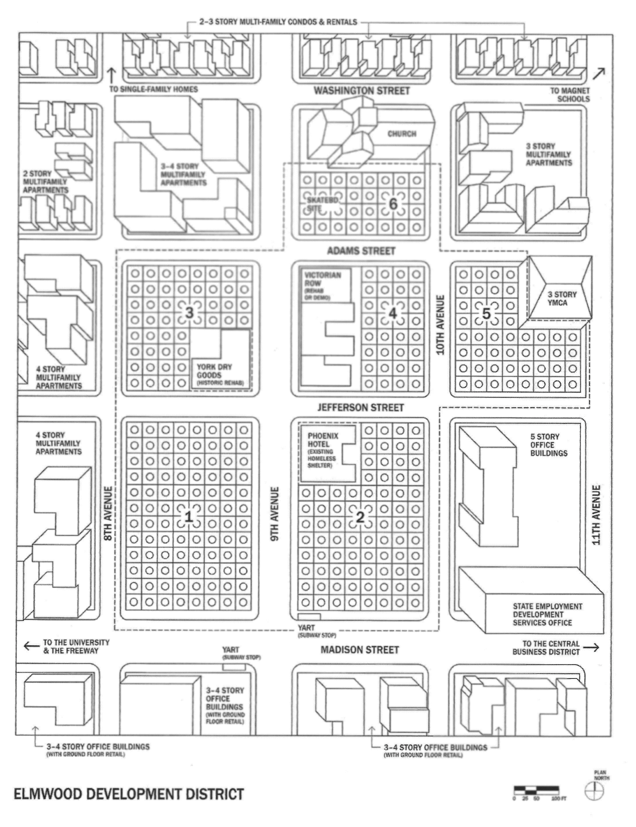
Targets
13.5% Return to Investors
$1.5M Revenue to City
Notes:
This is the base site plan along with the required targets.

Slide 22
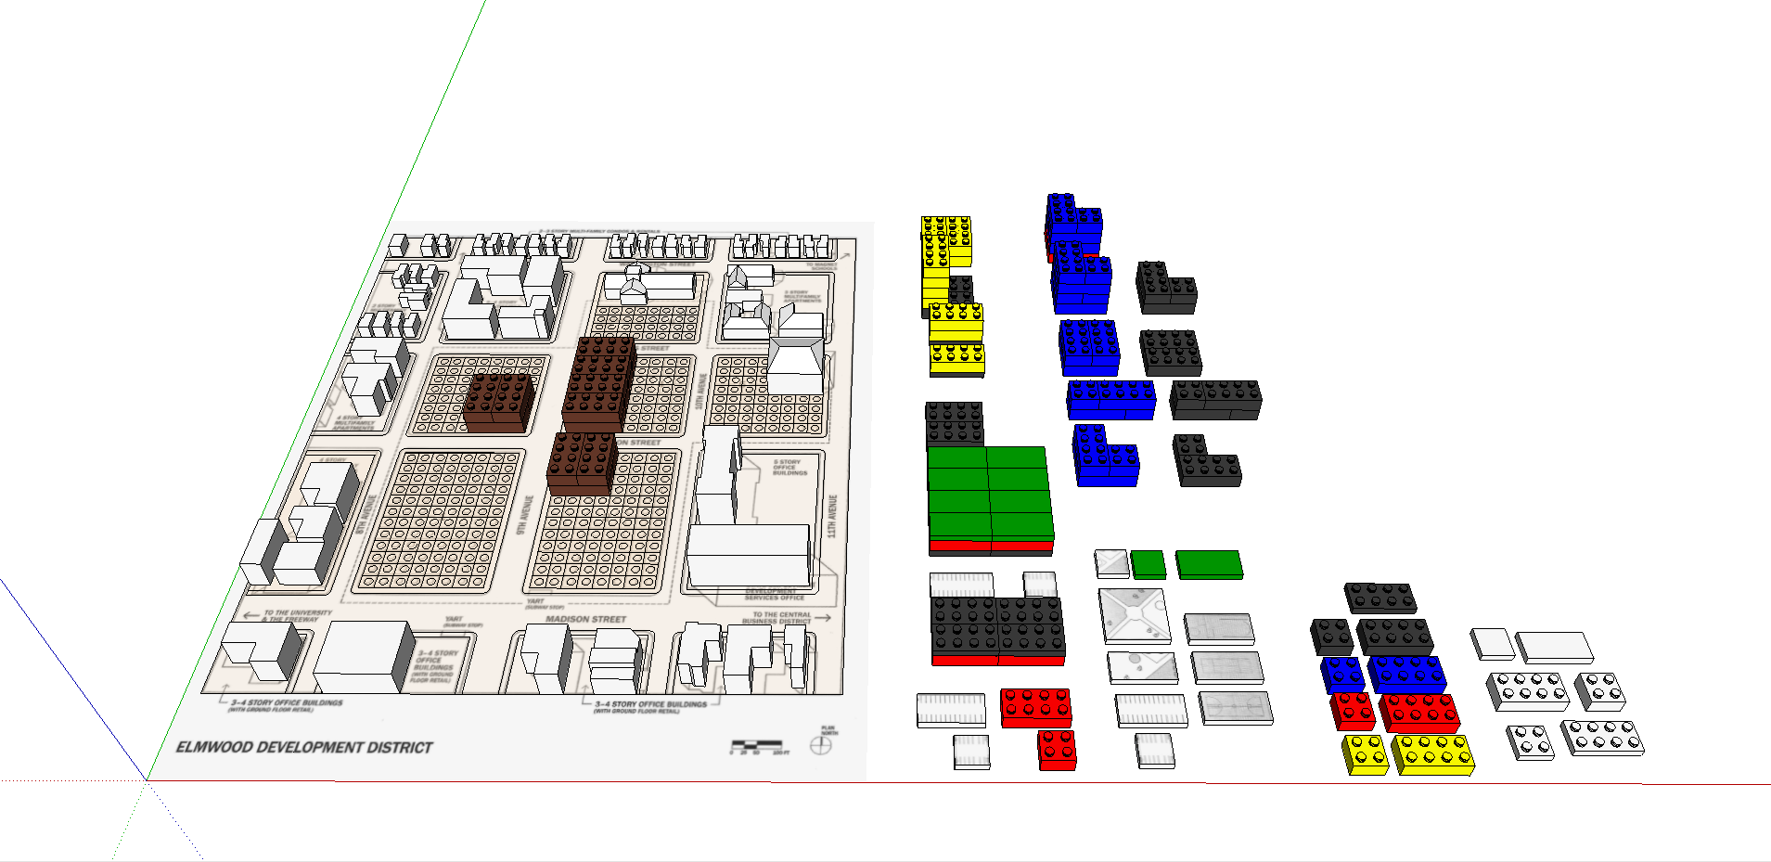
Notes:
I replicated the simulation with SketchUp.

Slide 23
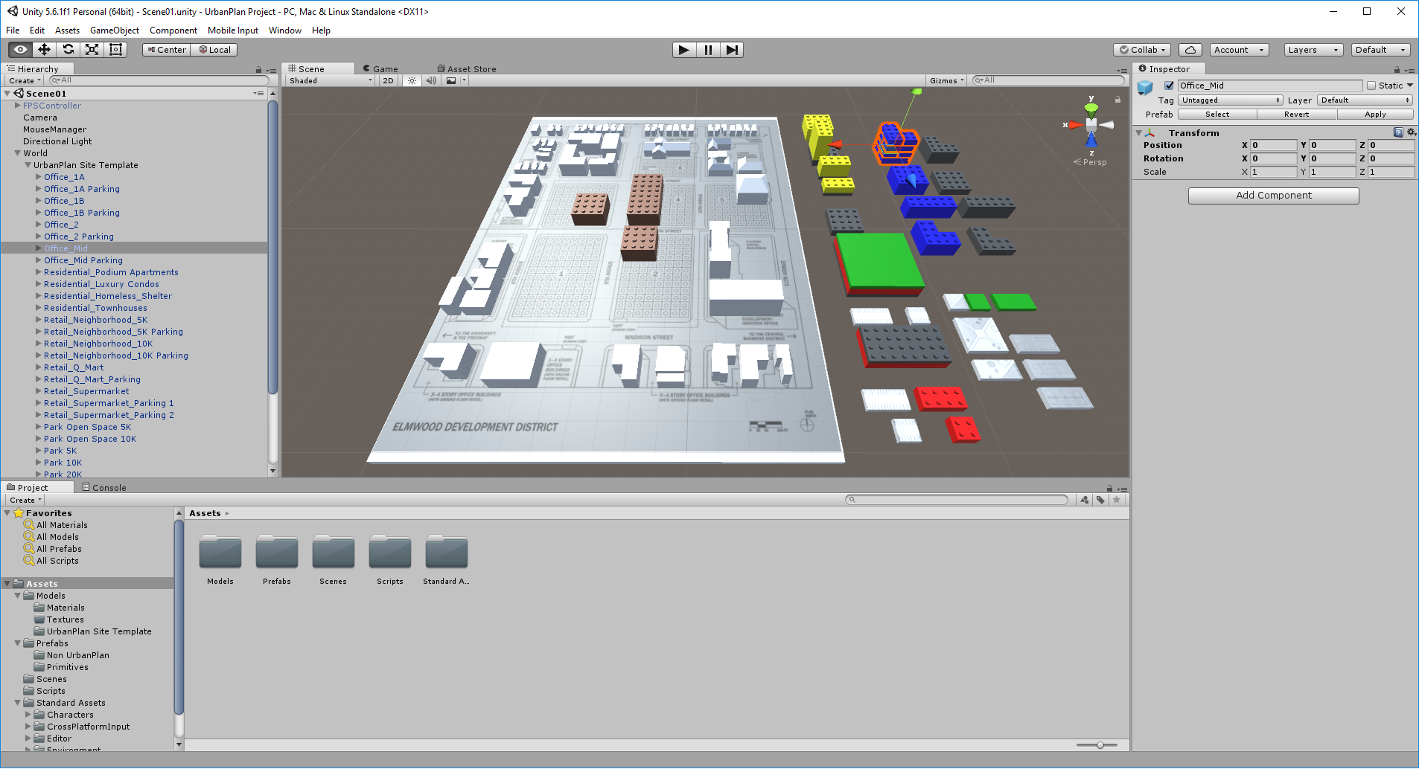
Notes:
I imported the models into Unity.

Slide 24
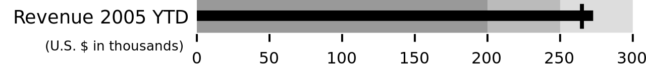
Notes:
This is an example of the dashboard scale I used. It tells you what the current level is along with the target level. This can be done with the typical dashboard red, yellow, green indicators but that is a tradeoff in visual readability.

Slide 25
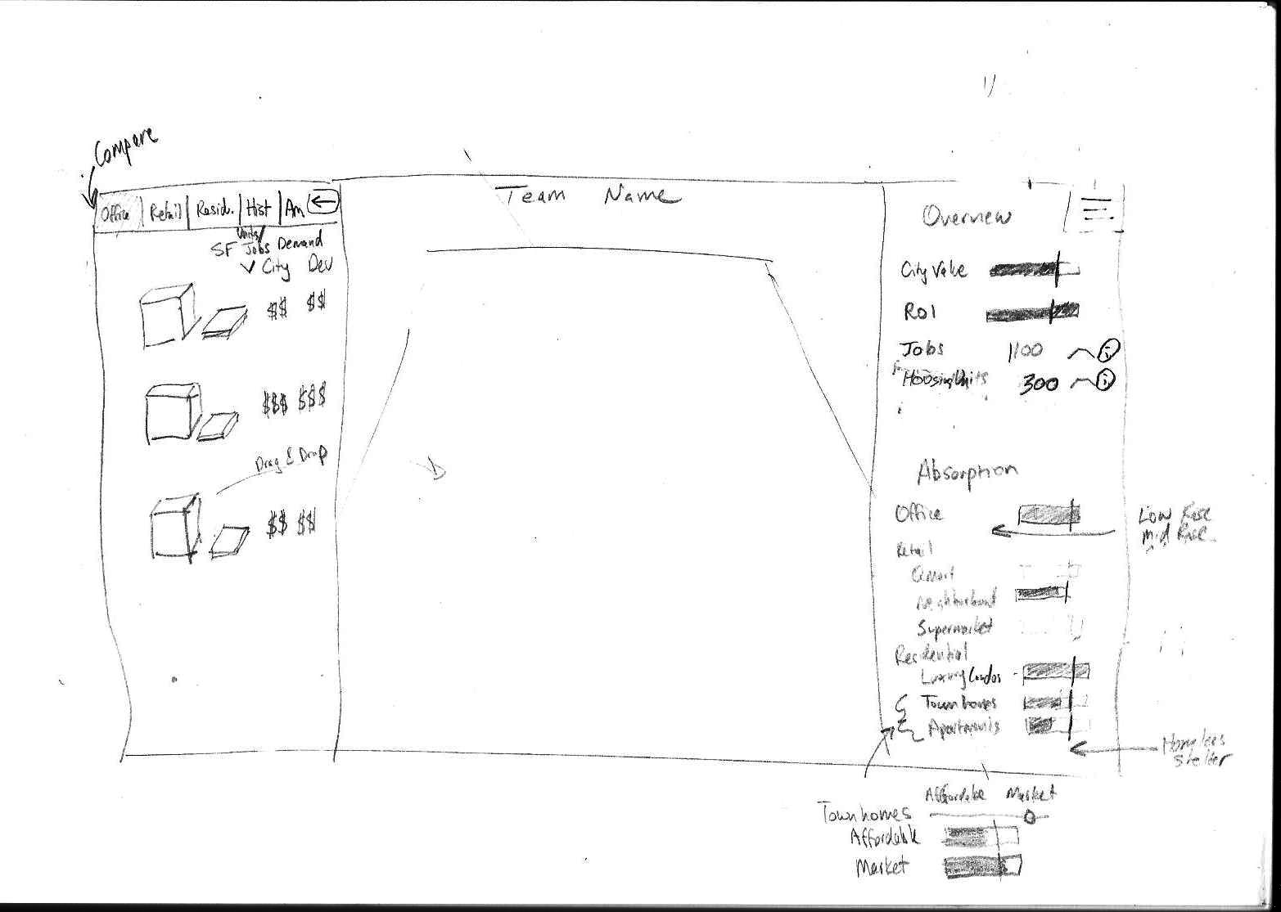
Notes:
This was the last version of the wireframe for the User Interface.

Slide 26
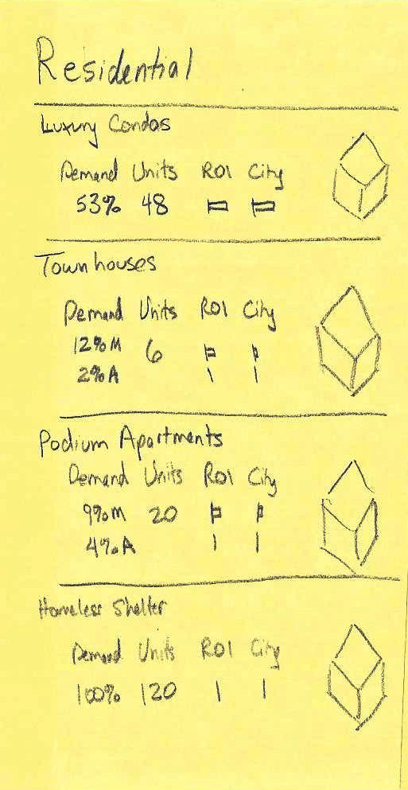
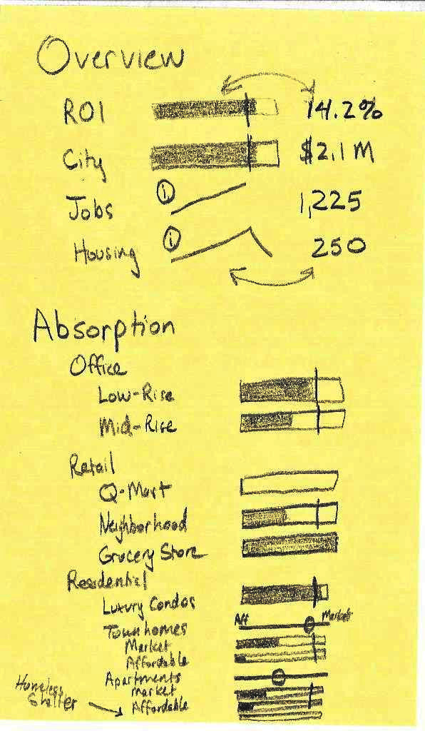
Notes:
This was the planning for the dashboard interface.

Slide 27
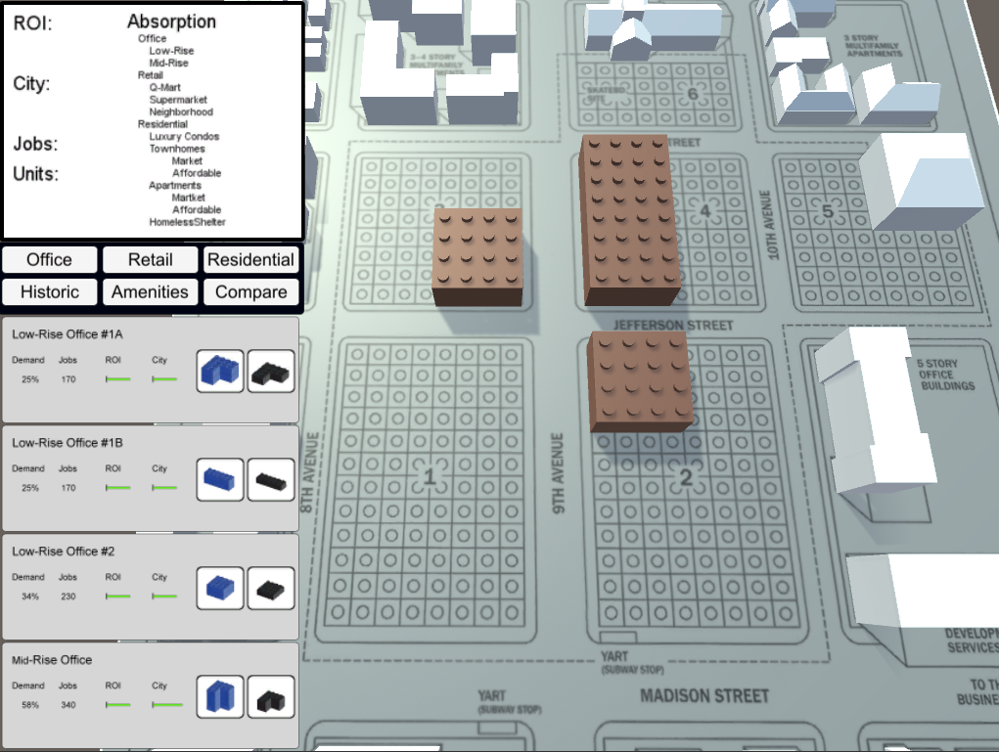
Notes:
Slides 27-54 simulate the app experience. Red boxes highlight buttons that would be clicked. Some buttons would add buildings and others open other menus.

Slide 28
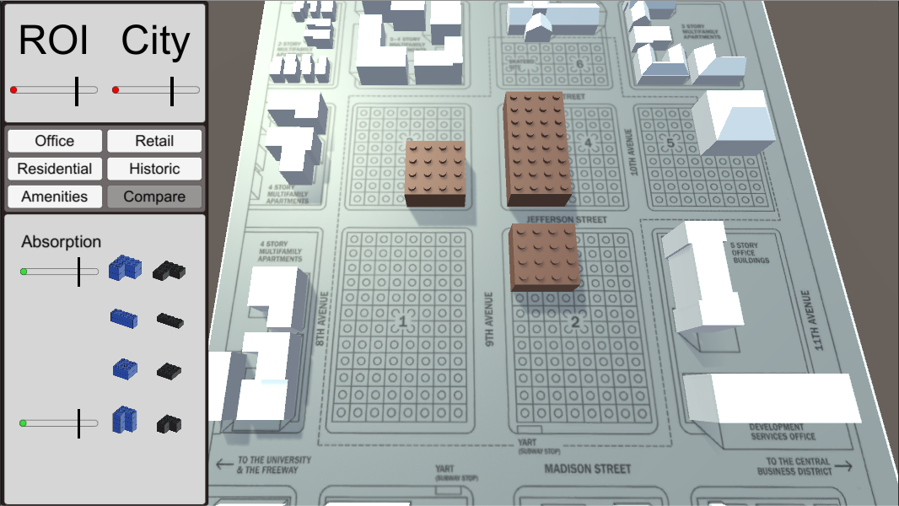
Notes:
Note that the return to the investors and city revenues are at the top of the dashboard. The brown buildings were given with options for historic preservation or adaptive reuse.

Slide 29
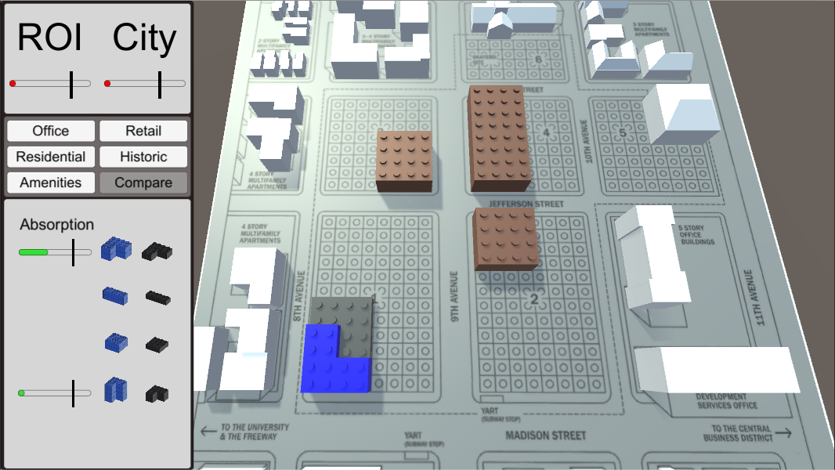
Notes:
Blue buildings are office space.

Slide 30
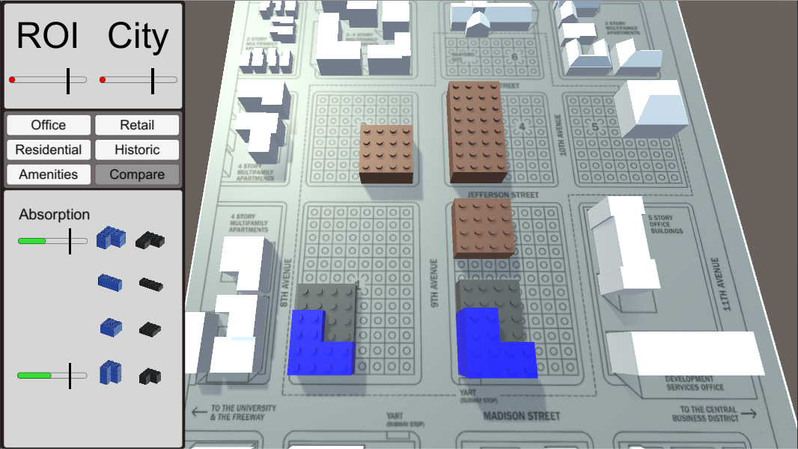

Slide 31
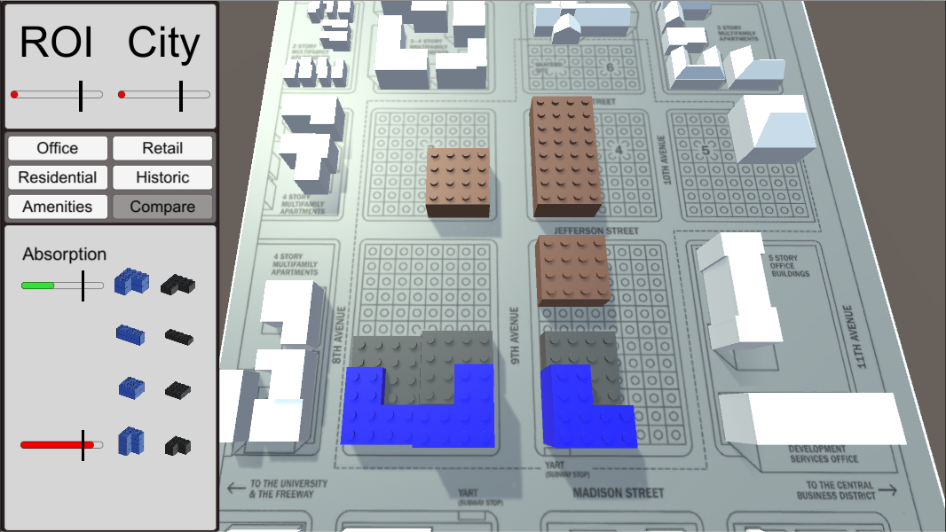
Notes:
With 3 office buildings, we appear to have overbuilt. Switching to the retail menu.

Slide 32
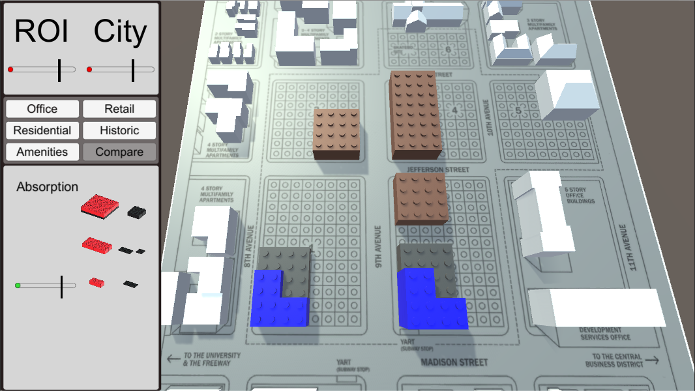
Notes:
These are the retail options including a big box store which rarely worked. Switching to residential.

Slide 33

Notes:
Here we have luxury condos (1 or 2 were always used), apartments, townhouses, and an option for a homeless shelter.

Slide 34
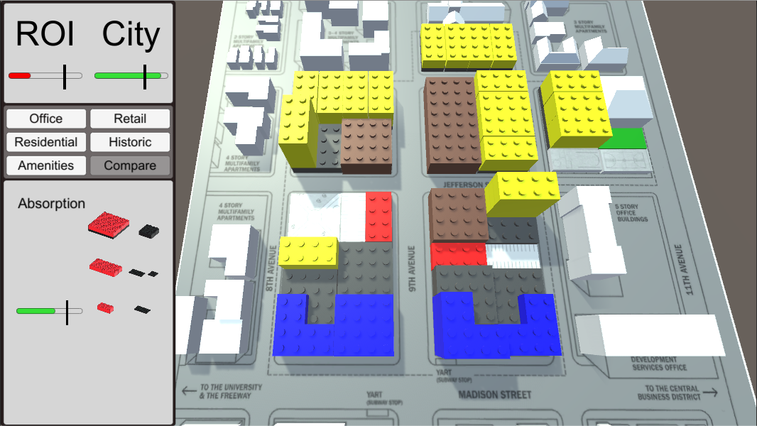
Notes:
After adding some office, residential, and a little retail, the city has met their target but the investors have not.

Slide 35
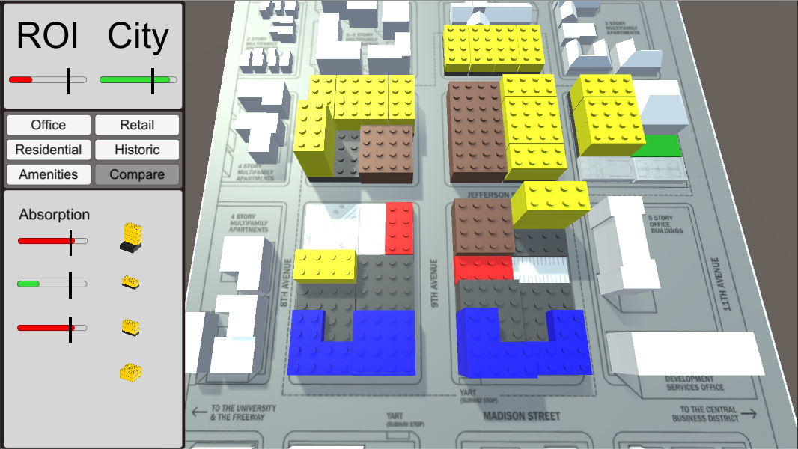
Notes:
We see that there is a little bit of overbuilding for the residential category.

Slide 36
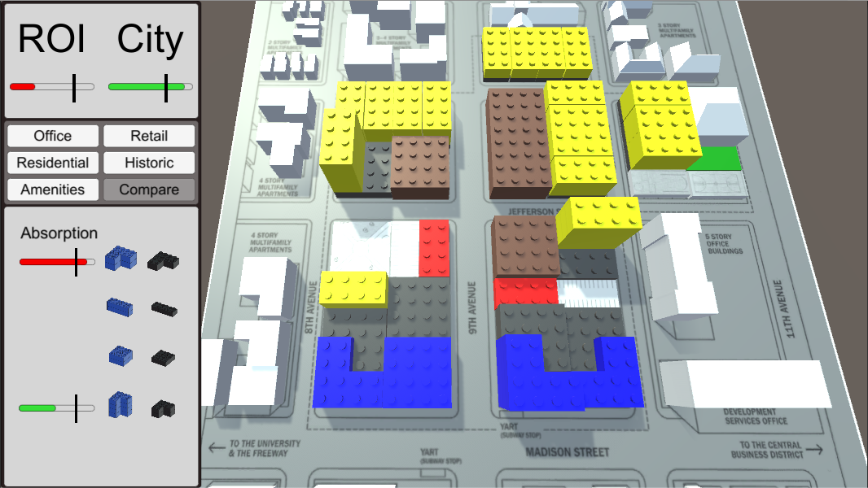
Notes:
And we see a little overbuilding for the mid-rise office.

Slide 37
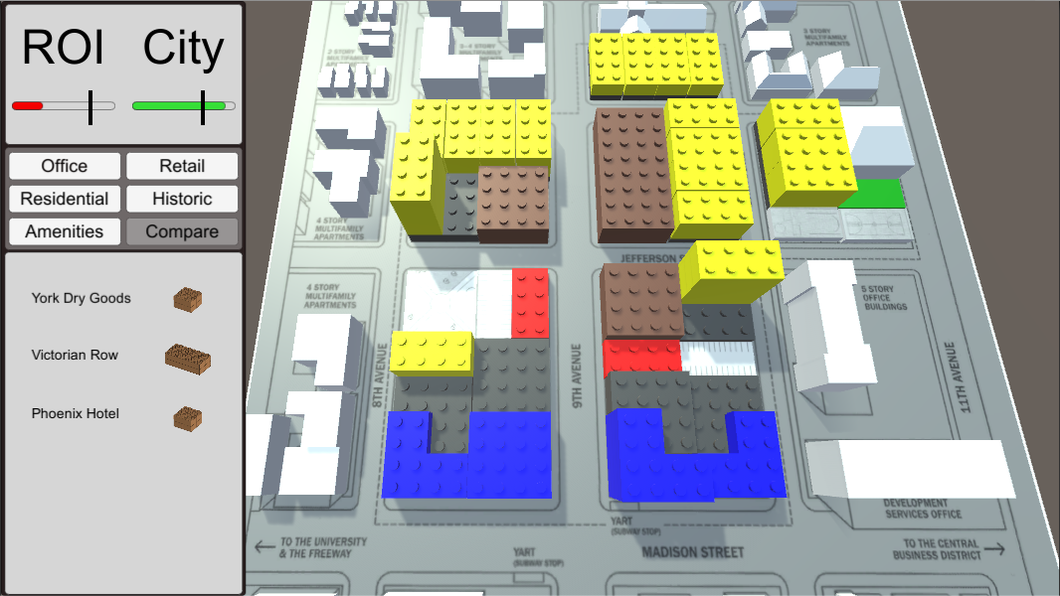
Notes:
These are the adaptive reuse buildings.

Slide 38
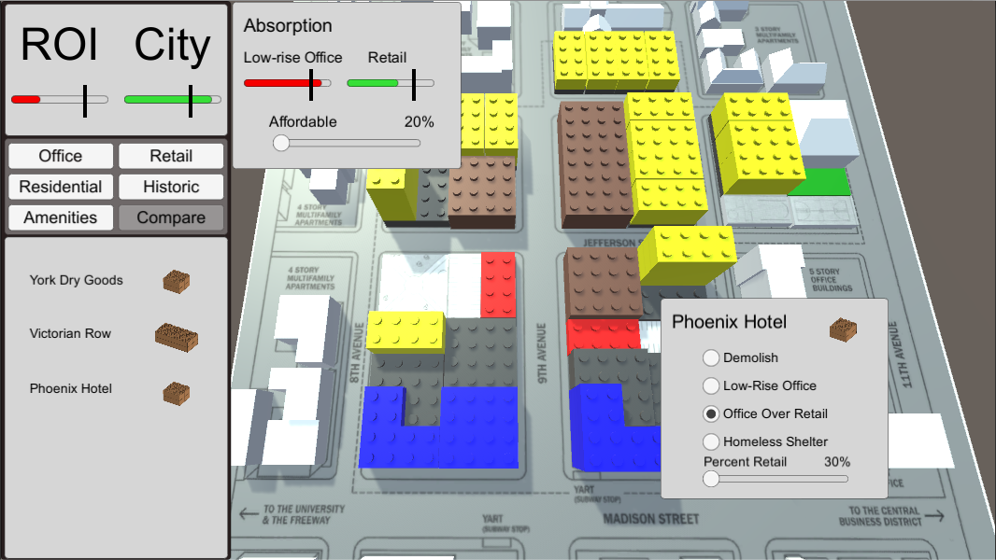
Notes:
This building has additional options for interior use categories and you have to decide whether to demolish it or keep it as office, retail, or a homeless shelter.

Slide 39
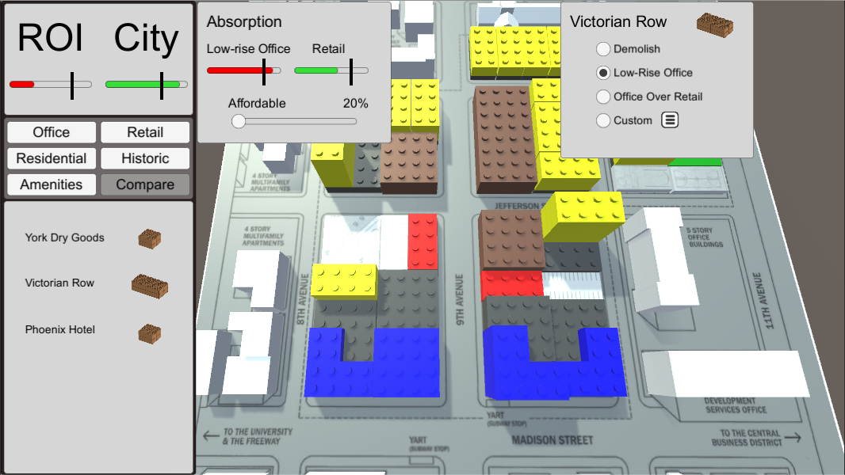
Notes:
This building had similar options.

Slide 40
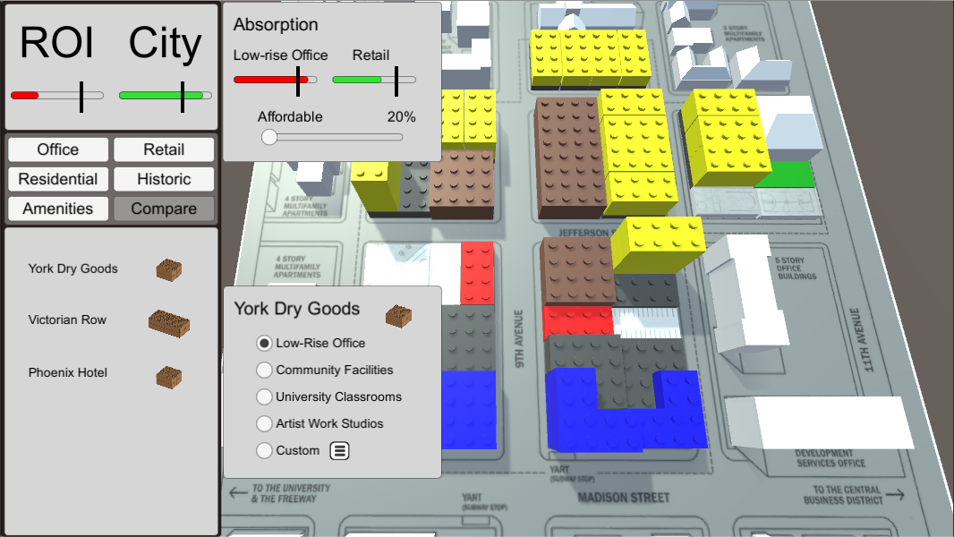

Slide 41


Slide 42
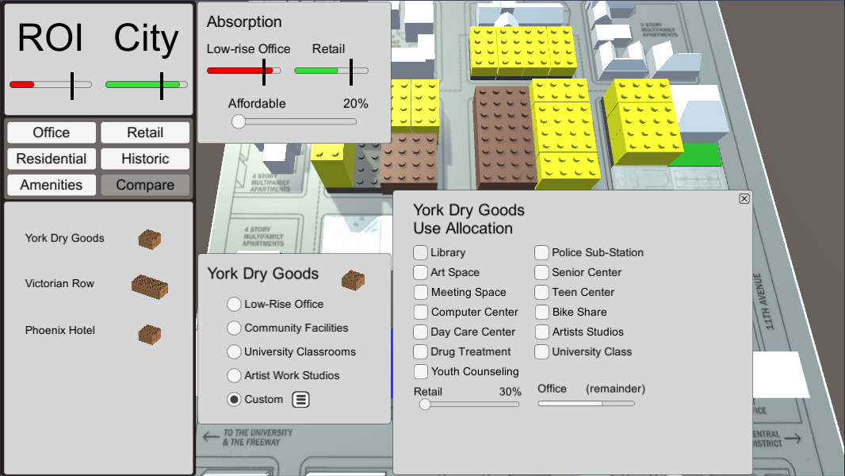
Notes:
These were the custom options to chose from with various returns and value to the community.

Slide 43

Notes:
After checking some, you could fill the rest with retail and office.

Slide 44


Slide 45


Slide 46
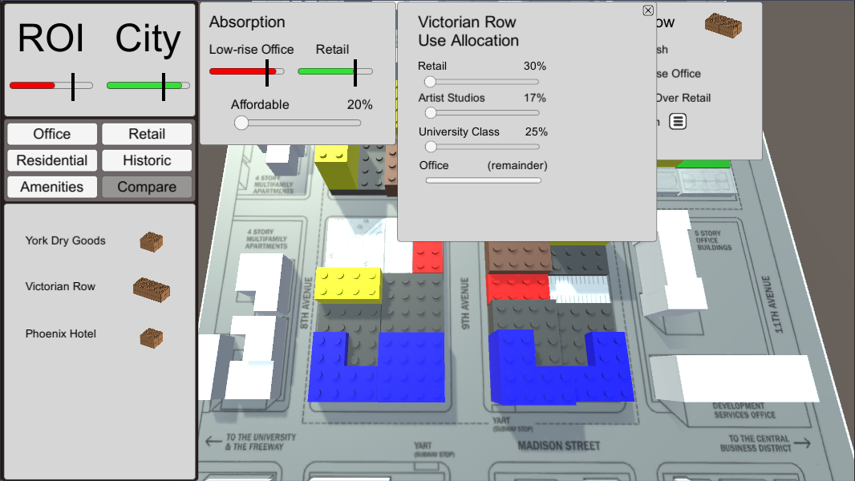

Slide 47
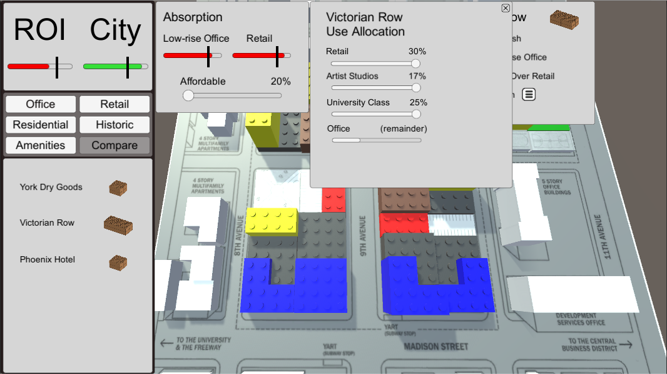

Slide 48


Slide 49
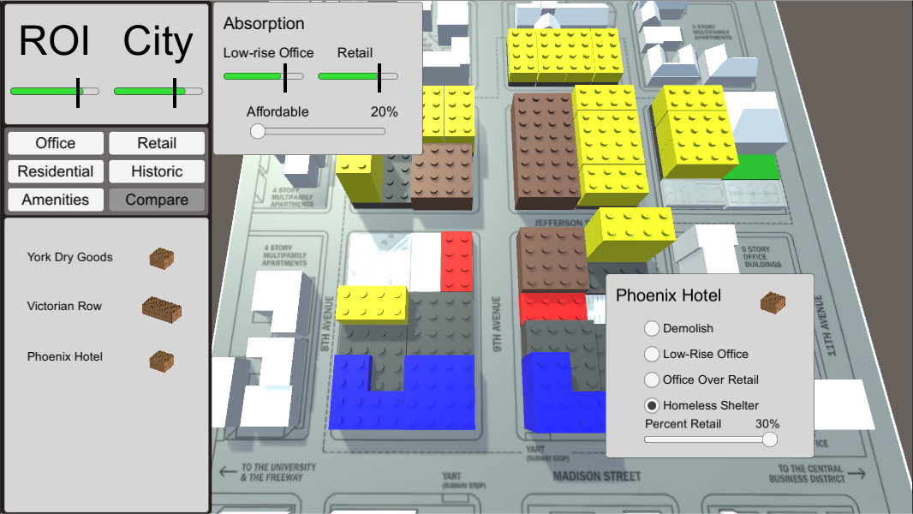

Slide 50
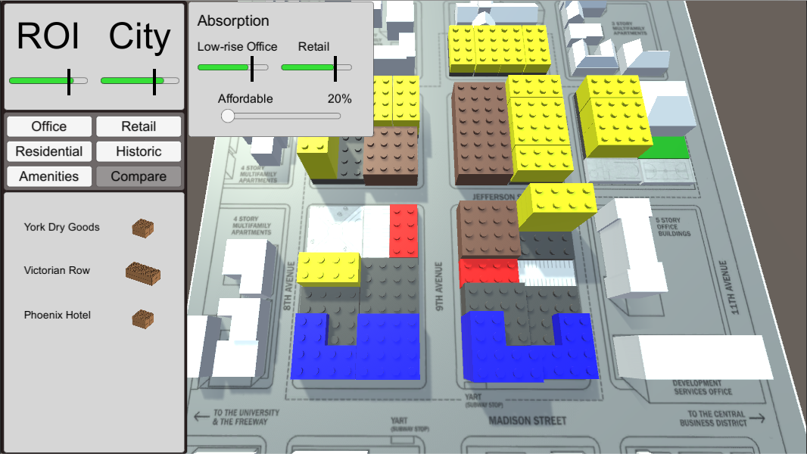

Slide 51


Slide 52
Notes:
You could decide how much of your residential would be subsidized as affordable.

Slide 53

Notes:
Increasing affordable housing decreases the city’s revenue.

Slide 54

Notes:
We now have a solution that can be presented to the city council.

Slide 55
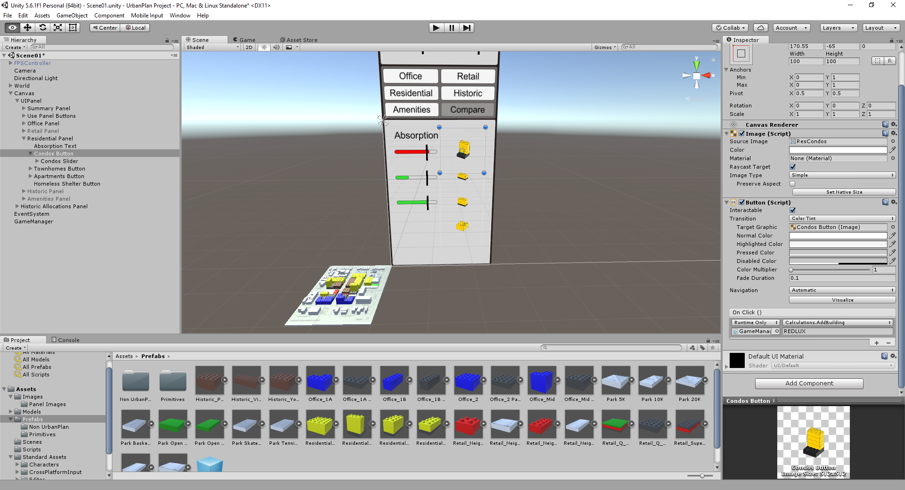
Notes:
This shows the Unity development environment. The highlighted region shows where the scripts are connected to the user interface. Notice that in Unity a user interface is accomplished by pointing one view toward the UI elements which are located far above the site plan. The UI view is then layered over the site plan view.

Slide 56
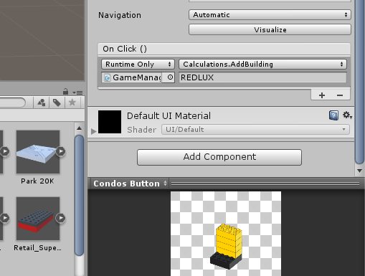
Notes:
A close up of the button click assignments.

Slide 57
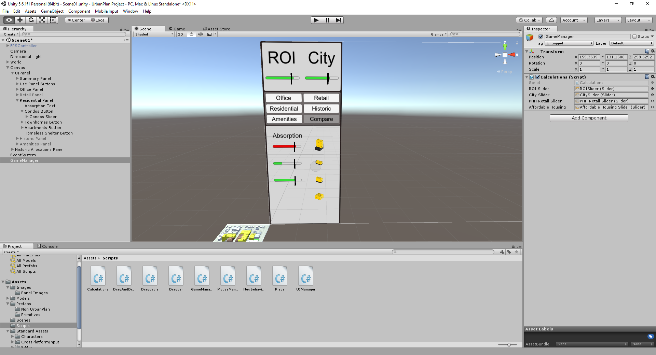
Notes:
This highlight shows how the slider bars are connected to the script.

Slide 58
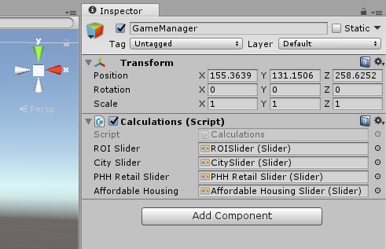
Notes:
A close up of the slider bar script assignments.

Slide 59
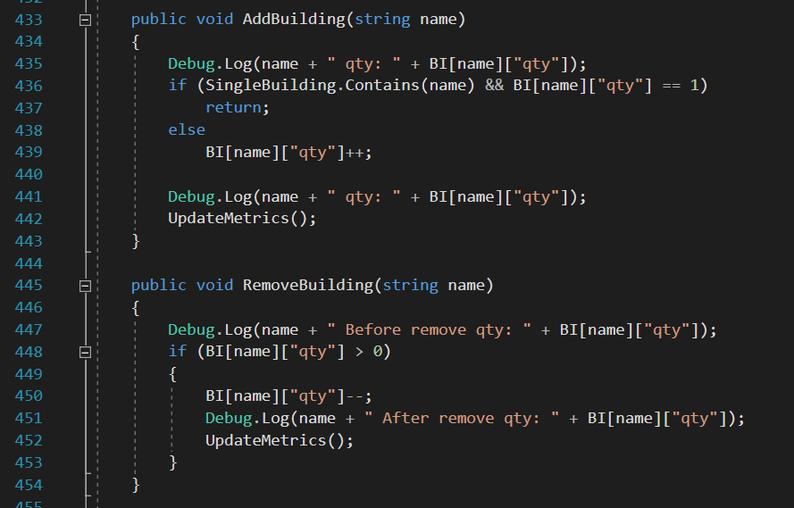
Notes:
A couple of the functions that updated the spreadsheet (adding and removing a building in this instance).

Slide 60
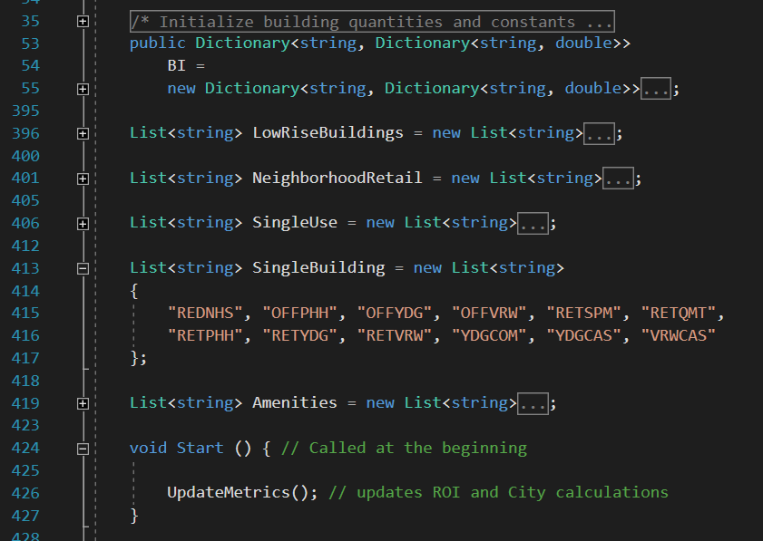
Notes:
This shows the initialization of the “spreadsheet” which I realized would best be represented as a dictionary of dictionaries because I needed to be able to update the quantity of buildings as well as the quantity of building space categories for absorption rates.

Slide 61
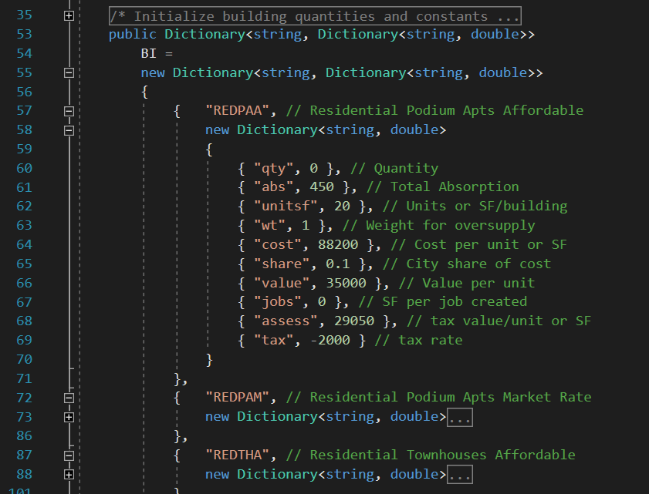
Notes:
Here I initialize the buildings and their attributes.

Slide 62
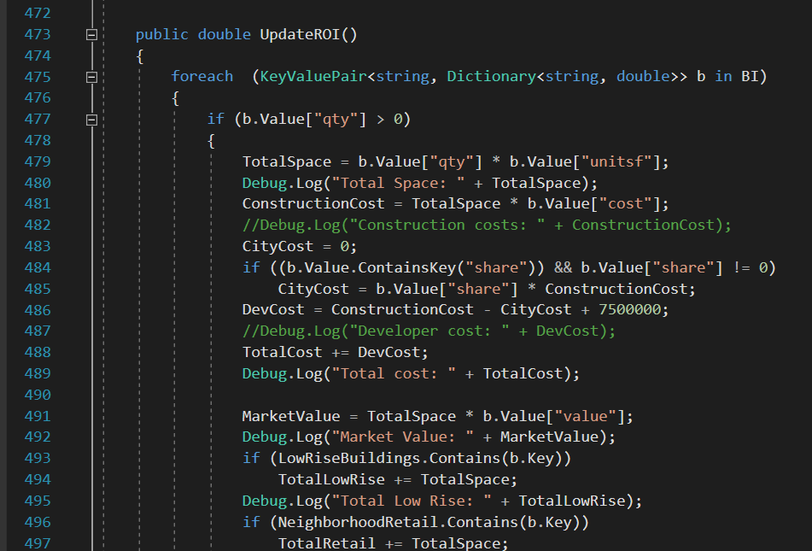
Notes:
This began the investor return calculation once the inventory changed.

Slide 63
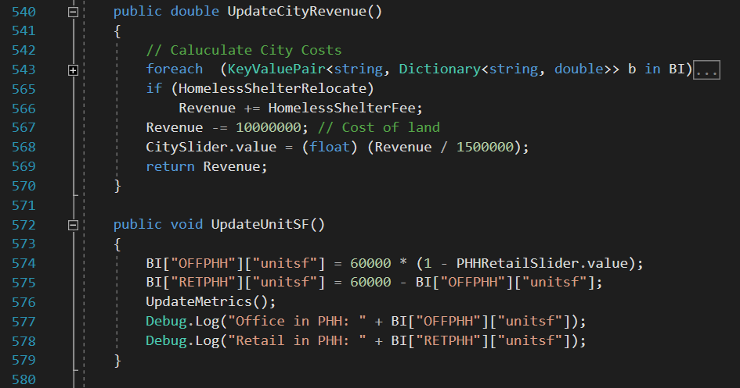
Notes:
We also had to track the effect of the homeless shelter on city revenue. The second function tracked the amount of office and retail space.

Slide 64

Notes:
Going beyond UrbanPlan, we could use existing geography ontologies for building modeling in the real world.

Slide 65
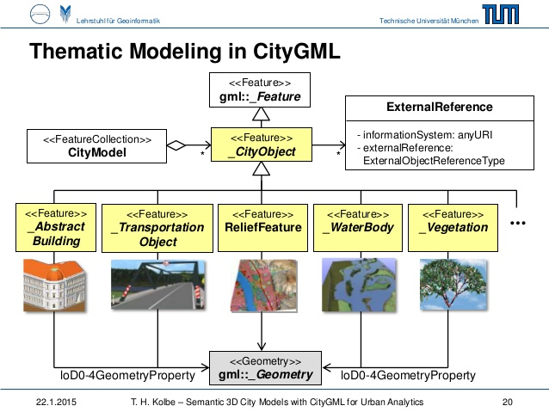
Notes:
This is the ontology (aka. Schema) for CityGML. It’s basically how we can interface between real elements and scripting.

Slide 66
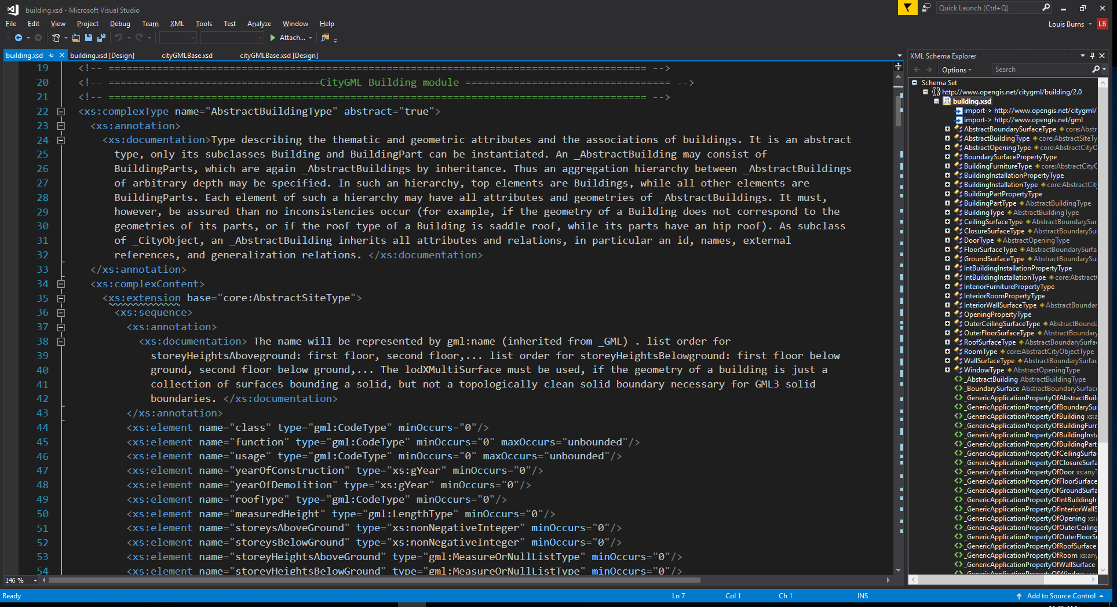
Notes:
This is an example of that interface.

Slide 67
Proposal
Create an interactive GIS game prototype to simulate the real estate development process
Instantiate the prototype to a local study area
Evaluate different Levels of Detail
Notes:
Part II of the project.

Slide 68
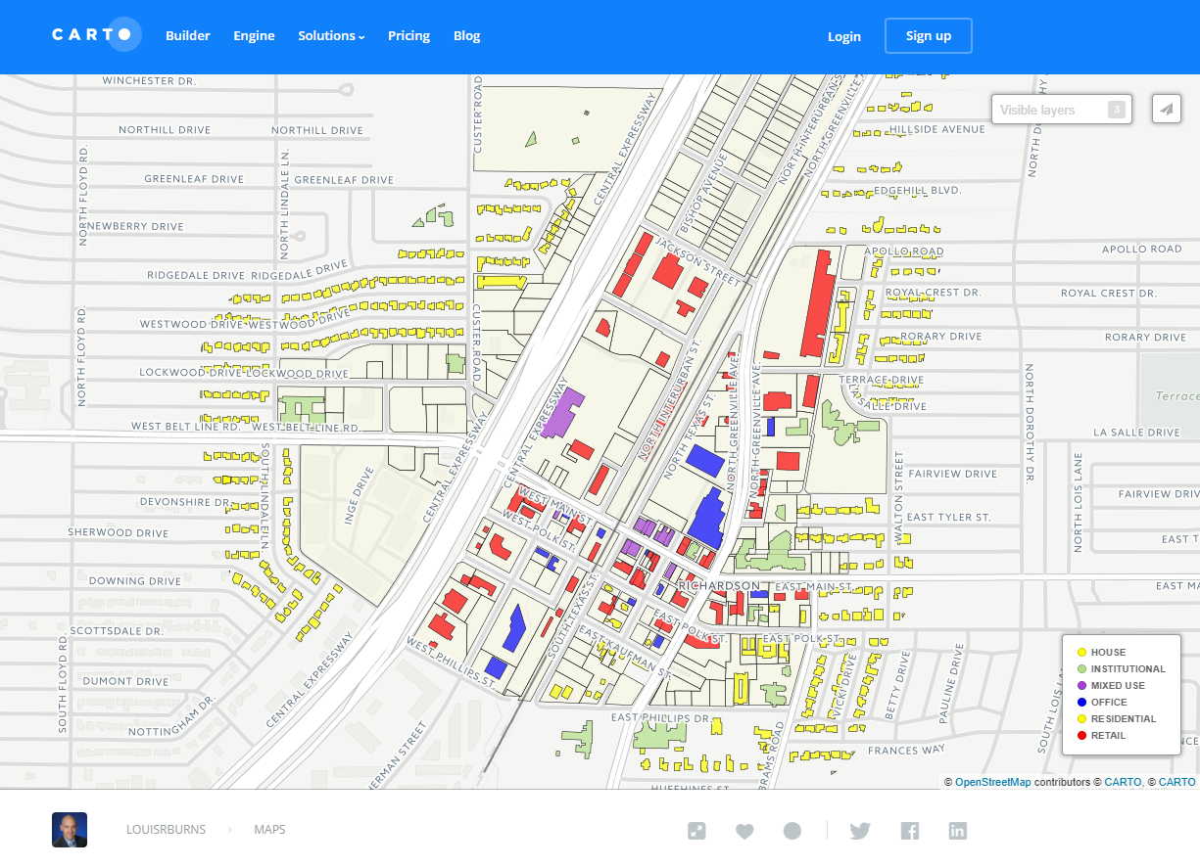
Notes:
This was the City of Richardson color coded by use in CartoDB.

Slide 69

Notes:
I created a 3D model of that map in ESRI ArcScene.

Slide 70

Notes:
I had to extrude the parcels as well so they could become clickable objects.

Slide 71


Slide 72

Notes:
I tried cleaning up the model in Maya but it was overkill.

Slide 73

Notes:
MeshLab was the right tool. It let me convert the ESRI objects to file types that Unity would recognize.

Slide 74

Notes:
Going through SketchUp to make sure the faces were facing the right direction. I could have used a plugin to give triangle faces too.

Slide 75

Notes:
Back in Unity.

Slide 76

Notes:
I found they imported into Unity as one object that I couldn’t edit separately. This plugin fixed that.

Slide 77

Notes:
Now I can color code by building use.

Slide 78

Notes:
I can layer all that on top of a Google satellite view.

Slide 79

Notes:
Here’s the 3D view.

Slide 80

Notes:
And finally, here’s the street view that we couldn’t get in UrbanPlan.

Slide 81





Notes:
This then was the workflow: ESRI products -> MeshLab -> SketchUp -> Unity.

Slide 82
Proposal
Create an interactive GIS game prototype to simulate the real estate development process
Instantiate the prototype to a local study area
Evaluate different Levels of Detail
Notes:
Part III

Slide 83

Notes:
This is the standard for level of detail.

Slide 84

Notes:
At this view, you don’t need much detail.

Slide 85

Notes:
I did create and skin the downtown block so they could be toggled on and off at the appropriate scale.

Slide 86

Notes:
At the street view, it starts to look like the street actually does.

Slide 87

Notes:
I tried importing the entire block directly using photogrammetry and Google Earth. It didn’t work very well.

Slide 88

Notes:
Going to building interiors, this is the inside of the Arts and Technology building at the University of Texas at Dallas. I cleaned up the model from the architect’s files so they would be able to run inside Unity as a virtual reality simulation. In this instance, we were doing a fire safety exercise where the microwave in the breakroom would catch on fire. If you caught it in time, you could use the fire extinguisher to put it out.

Slide 89

Notes:
In Unity, you have the virtual room high above the virtual environment similar to how the UrbanPlan UI was constructed.

Slide 90

Notes:
Here you see an interactive element whereby you would locate and deploy the fire extinguisher. On my VR team, I was the modeler and so was responsible for importing, cleaning, and texturing the building as well as building objects inside it. The other four members of my team were tasked with making fire spread (not shown here).

Slide 91
Project Conclusions
Charrettes often a once-a-decade event
Not everyone can attend
Those who can are not representative
Design input is limited
Very little iteration
Very little interaction with data
No way to check outcomes
Fixing it later is HARD
Play whenever
Play wherever
Everyone can play
Players are designers
Play over and over
Instant feedback
Outcomes play tested
Fixing it is FUN
Notes:
These are the problems and solutions solved by interactive geodesign as presented here.

Slide 92
Selected References
https://en.wikipedia.org/wiki/File:Favela_Jaqueline_(Vila_S%C3%B4nia)_01.jpg
Batty, Michael. 2013. “Defining Geodesign (= GIS + Design?).” Environment and Planning B: Planning and Design 40 (1): 1–2. doi:10.1068/b4001ed.
https://www.flickr.com/photos/playstationblogeurope/14336357556 (surgery game)
https://media.defense.gov/2010/Sep/09/2000327869/-1/-1/0/100909-F-9322R-037.JPG (surgery simulation)
https://www.flickr.com/photos/haljackey/8305292889 (SimCity)
“Spring Valley Station District.” 2003. Calthorpe Associates. http://www.cor.net/index.aspx?page=452.
https://commons.wikimedia.org/wiki/File:Bullet_Graph_Example.svg
https://louisrburns.carto.com/viz/62cd5162-a283-11e5-81ac-0ef24382571b/public_map
https://image.slidesharecdn.com/20150122presentacio3dcitymodels-150123023244-conversion-gate02/95/semantic-3d-city-models-with-citygml-20-638.jpg?cb=1421980555
http://opendata-richardson.opendata.arcgis.com
http://www.dallascad.org/GISDataProducts.aspx

Slide 93

Questions?

